Slide 1

Exercise 2 Tracking & Detection
Lecture: Tracking and Detection in Computer Vision by Dr. Slobodan Ilic
Wintersemester 2017/18
Chair for Computer Aided Medical Procedures & Augmented Reality
Technische Universität München
WANG, Pengyuan & GAO, Yingqiang
Student of RCI
25.01.2018

Slide 2
Task description
Use Random Forest to solve the problem of Object classification and Detection
Given:
separate train and test images for each object and background.
the ground truth bounding boxes for each object in the image
To solve:
A Decision Tree Classifier
A Random Forest Classifier
Object detection

Slide 3
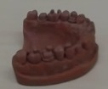
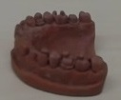
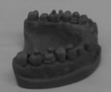
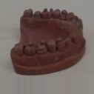

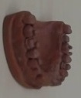
Task 1 Image processing and HOG descriptor
image visualization:
original
flip
gray scale
padding
resize
rotate

Slide 4
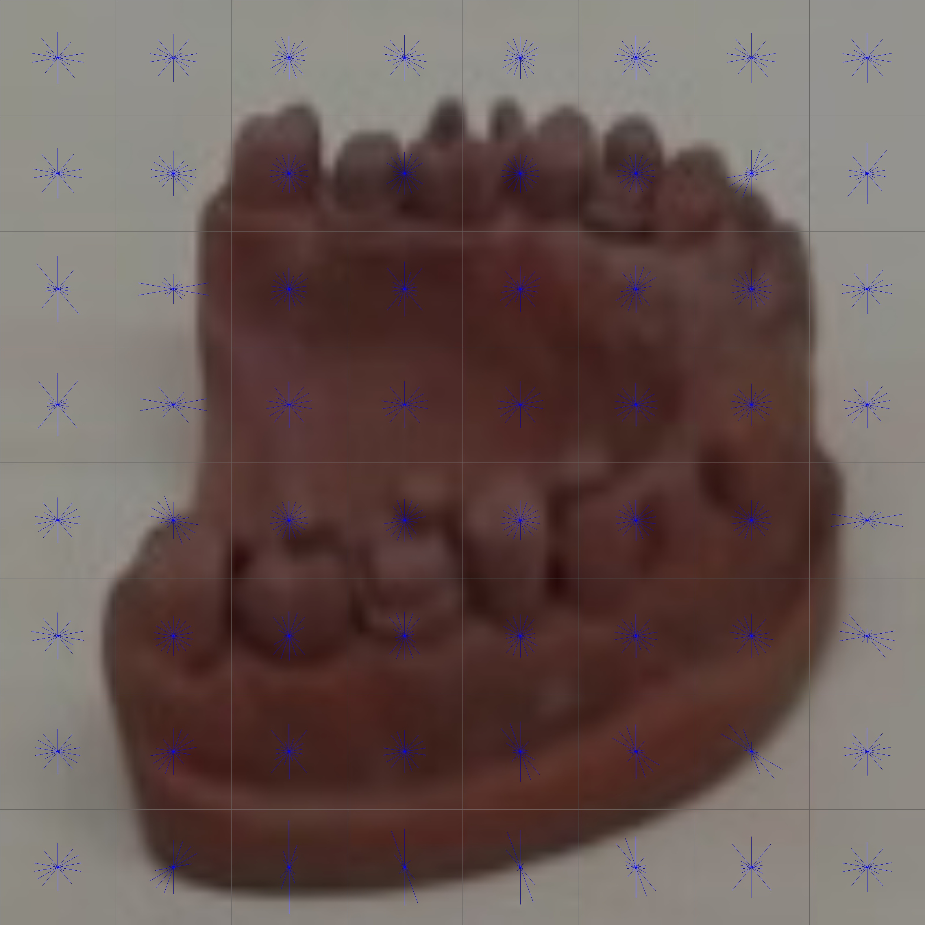
Task 1 Image processing and HOG descriptor
HOG descriptor
* winSize, blockSize, blockStride, cellSize, nbins = (640,640), (80,80), (80,80), (80,80), 9

Slide 5
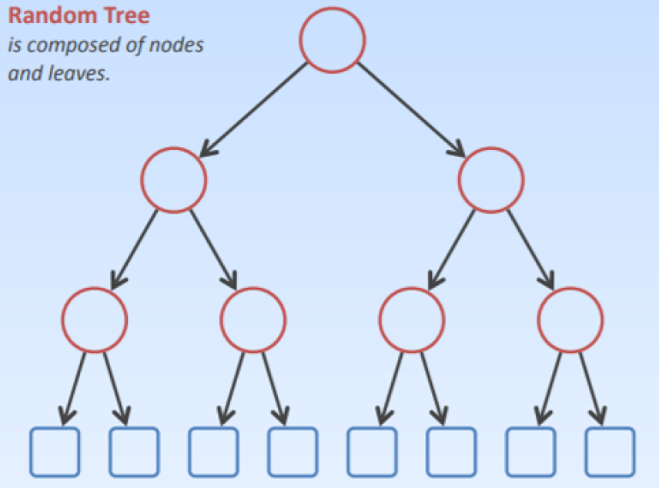
Task 2 Object Classification
Decision Tree Classifier
Create a Decision Tree:
cv::ml::DTrees.create()
Set parameters:
void setCVFolds( int val );
void setMaxCategories( int val );
void setMaxDepth( int val );
void setMinSampleCount( int val );

Slide 6
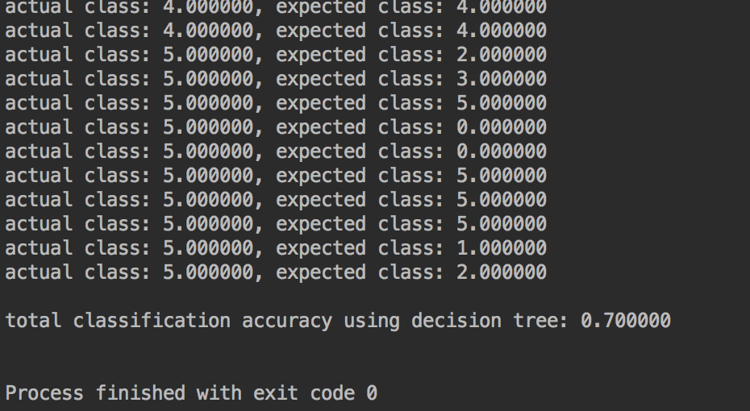
Task 2 Object Classification
Decision Tree Classifier

Slide 7
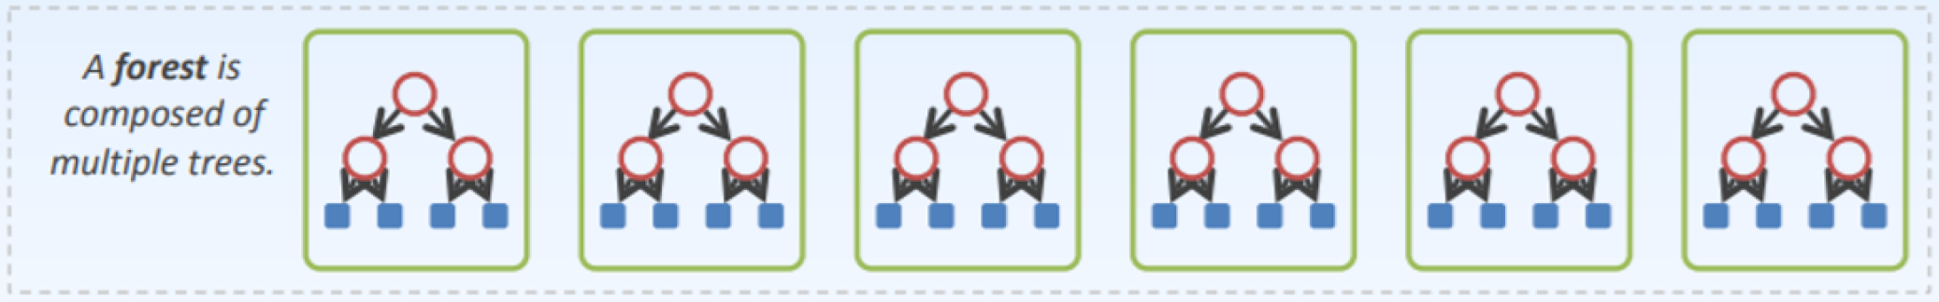
Task 2 Object Classification
Random Forest Classifier
Set up Random Forest Classifier by creating 100 Decision Tree and vote for classification result
Using different data to train each Decision Tree. Here we randomly use 1/3 images of each object’s total training data in order to operate randomly
The predict process we use all the test data

Slide 8
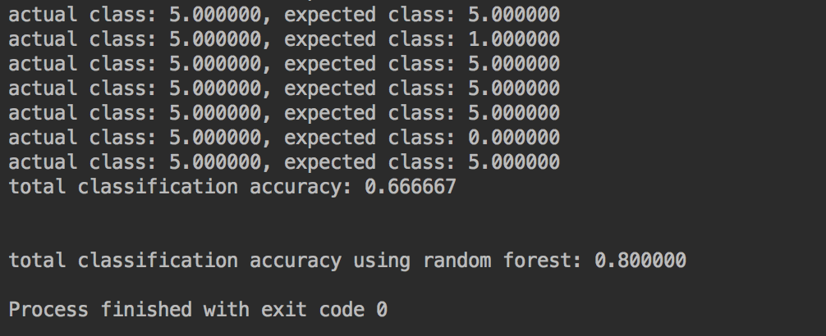
Task 2 Object Classification
Random Forest Classifier

Slide 9
Task 3 Object Detection
Object Detection using Random Forest Classifier
General steps for Object Detection:
Generate Bounding Boxes
Classify Contents within each Bounding box
Non-Maximum Suppression
Evaluate the detection result

Slide 10
Task 3 Object Detection
Generate Bounding Boxes
Generating bounding box
Resize the image to 640*380
Box size from 60 to 160, with interval 20 and ratio 1:1
Sliding stride 10 pixel
Classify Contents within each Bounding box
Random Forest with 32 Decision Trees
Applying pretrained Random Forest Classifier to each sliding window and extract HOG descriptors
Filter out windows with low confidence

Slide 11
Task 3 Object Detection
Non-Maximum Suppression
Sort the windows from full-vector according to the confidence, the window with the highest confidence (denoted as best window) is pushed in the front
Calculate the IOU between the best window and all the other windows. If the IOU is greater than a predefined threshold, then pop this window and store the best window to the remain vector
Repeat until the full-vector has the length 1, do nothing about the last window
Keep only the windows in remain vector with greatest confidence if intersected

Slide 12
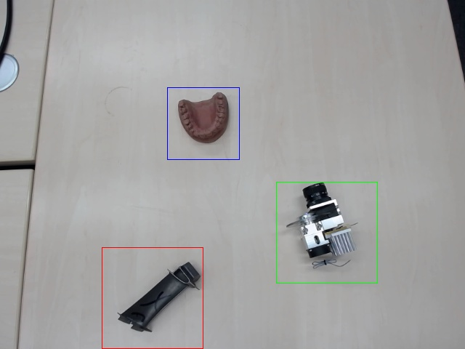
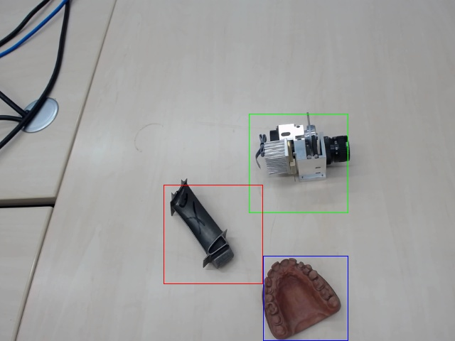
Task 3 Object Detection

Slide 13
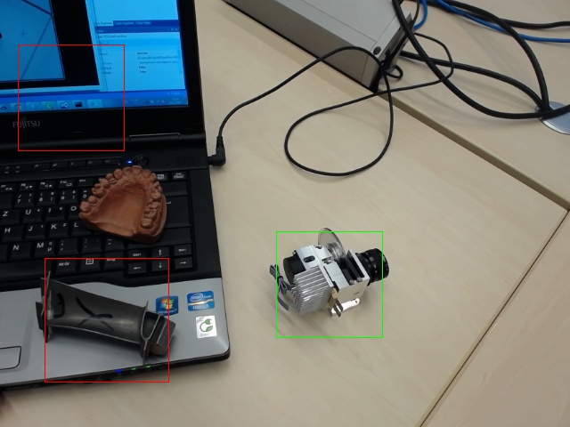
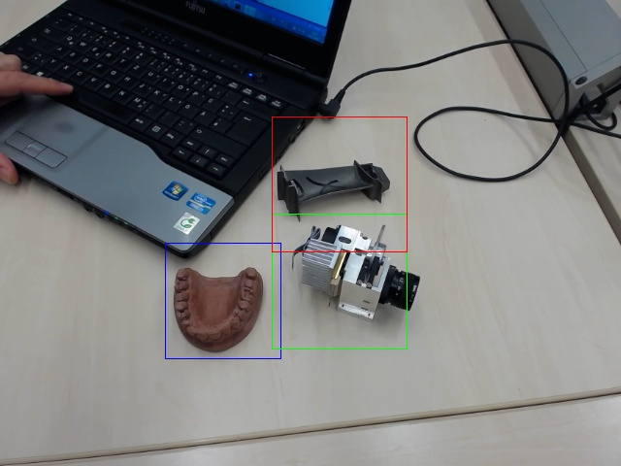
Task 3 Object Detection

Slide 14
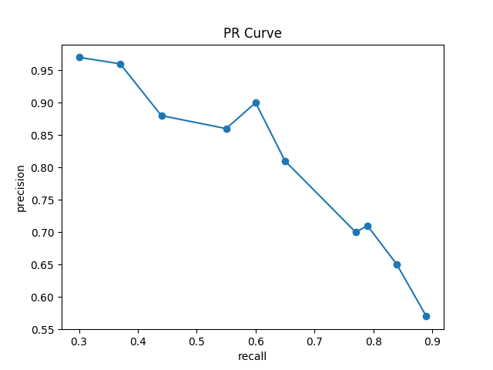
Task 3 Object Detection
Evaluate the detection result

Slide 15
Exercise 2 Tracking & Detection
Thanks for your attention!

